Slide 1

Ethics, Bias, and Fairness Part III:
Detecting and Mitigating Disparities
Rayid Ghani and Kit Rodolfa

Slide 2
Data and AI Ethics Issues
Privacy
Data Ownership
Bias, Equity, & Fairness
Transparency
Trustworthiness and Accountability

Slide 3
Data and AI Ethics Issues
Privacy
Data Ownership
Bias, Equity, & Fairness
Transparency
Trustworthiness and Accountability

Slide 4
Many Bias Measures: How do we select what we care about?

Slide 5
So… what does this mean?
Sadly, no… we can’t have it all!
But this also doesn’t mean fairness is unachievable or we shouldn’t bother.
Instead, it means we have to carefully consider and choose the appropriate fairness metrics for our context

Slide 6
Some Motivating Case Studies
Lead Poisoning
Blight Violations
Student Tutoring

Slide 7
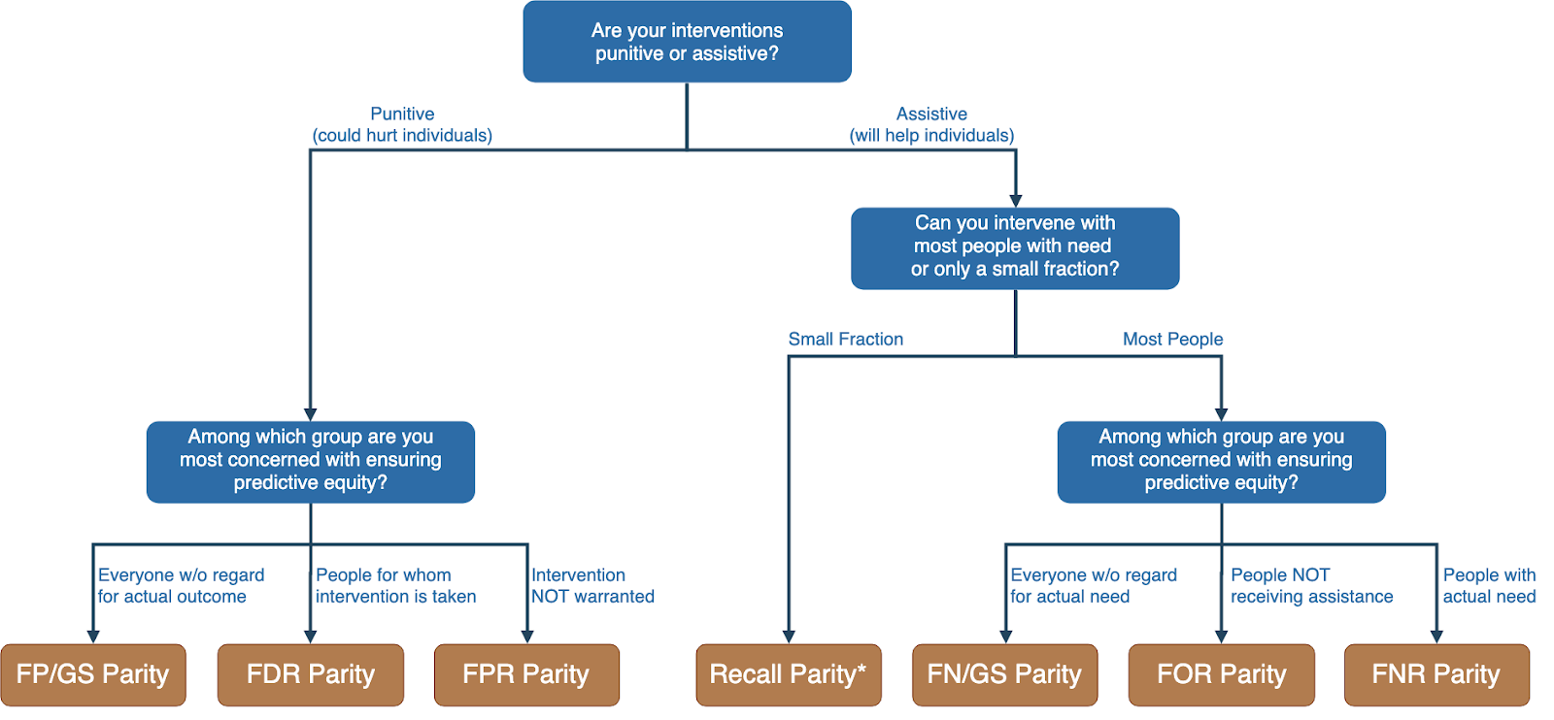
Translating policy goals to fairness metrics

Slide 8
Is the fairness tree “the answer”?

Slide 9
Is the fairness tree “the answer”?
No… but it’s intended as a starting point to help guide a conversation between ML experts, policy makers, and those affected by the decisions.
Ultimately, the choice of fairness metric(s) is highly dependent on context and stakeholder values.

Slide 10
Legal and Social Principles
Choices about fairness and equity are implicit in any decision process but being made explicit by the growing use of algorithmic decision support.

Slide 11
Legal and Social Principles
Choices about fairness and equity are implicit in any decision process but being made explicit by the growing use of algorithmic decision support. What implicit choices about fairness are encoded when we say…
Beyond a reasonable doubt? (e.g., criminal court)
The preponderance of evidence? (e.g., civil court)
Probable cause? (e.g., indictment by grand jury)
Innocent until proven guilty?

Slide 12
Legal Perspectives and Challenges
Title VII of US Civil Rights Act – Job Discrimination
Disparate Treatment (intentional discrimination)
Disparate Impact (regardless of intention)
14th Amendment
Equal Protection (under laws and government actions)
“Strict Scrutiny” Standard: compelling state interest, narrowly tailored, and least restrictive means
Notes:
14th Amendment often interpreted to prohibit racial classification in most cases (that is, taking race into account in state decision-making) as well as racial intentions/discriminatory purpose

Slide 13
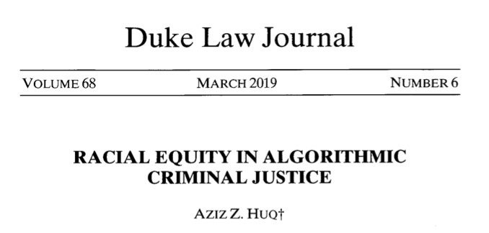
Legal Perspectives and Challenges

Slide 14
Legal Perspectives and Challenges
What Challenges Does Huq Identify Applying Current Legal Standards to Algorithmic Decision Making?

Slide 15
Legal Perspectives and Challenges
What Challenges Does Huq Identify Applying Current Legal Standards to Algorithmic Decision Making?
Expanded scale and reach of state power
Durability of errors – need for special skills to update/fix problems
What does “discriminatory intent” mean in this context?
Unclear how to apply “anticlassification” standard of equal protection

Slide 16
Legal Perspectives and Challenges
Difficulties with Equal Protection’s “Anticlassification” Standard:
Simply omitting race as a feature doesn’t ensure an algorithm is “colorblind” – too much correlated information in other features
Accounting for race may in fact be needed to decrease disparities

Slide 17
Legal Perspectives and Challenges
Drug Possession Rates
 | Black | White
Baseball Cap | 0% | 100%
No Cap | 2% | 2%

Slide 18
Legal Perspectives and Challenges
Drug Possession Rates
 | Black (25% of Pop.) | White (75% of Pop.)
Baseball Cap | 0% | 100%
No Cap | 2% | 2%
Race-Blind Policy:
75% Precision
Many Needless Searches of Minorities

Slide 19
Legal Perspectives and Challenges
Drug Possession Rates
 | Black (25% of Pop.) | White (75% of Pop.)
Baseball Cap | 0% | 100%
No Cap | 2% | 2%
Race-Aware Policy:
100% Precision
No Needless Searches of Minorities

Slide 20
Legal Perspectives and Challenges
How does Huq suggest modifying our criteria for assessing discrimination in this new context?

Slide 21
Legal Perspectives and Challenges
“Rather than asking about abstract definitions of fairness, a criminal justice algorithm should be evaluated in terms of its long-term, dynamic effects on racial stratification… [and] focus on the net burden thereby placed on the racial minority.”

Slide 22
Where does this leave us?
What can we do to understand bias and improve fairness of our systems?
Bias and equity audits
Try to fix the input data
Optimize for fairness in model training
Choose fair models during model selection
Post-hoc adjustments to de-bias model scores
Measure relative effectiveness of interventions across groups and develop better-tailored interventions

Slide 23
Where does this leave us?
What can we do to understand bias and improve fairness of our systems?
Bias and equity audits
Try to fix the input data
Optimize for fairness in model training
Choose fair models during model selection
Post-hoc adjustments to de-bias model scores
Measure relative effectiveness of interventions across groups and develop better-tailored interventions

Slide 24
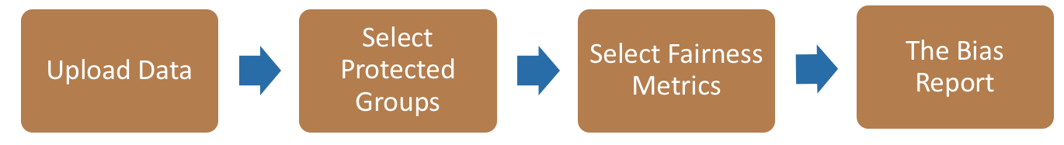

Bias Audit flow
Race
Sex
Age
Equal False
Omission Rate
Risk Score and Outcomes

Slide 25
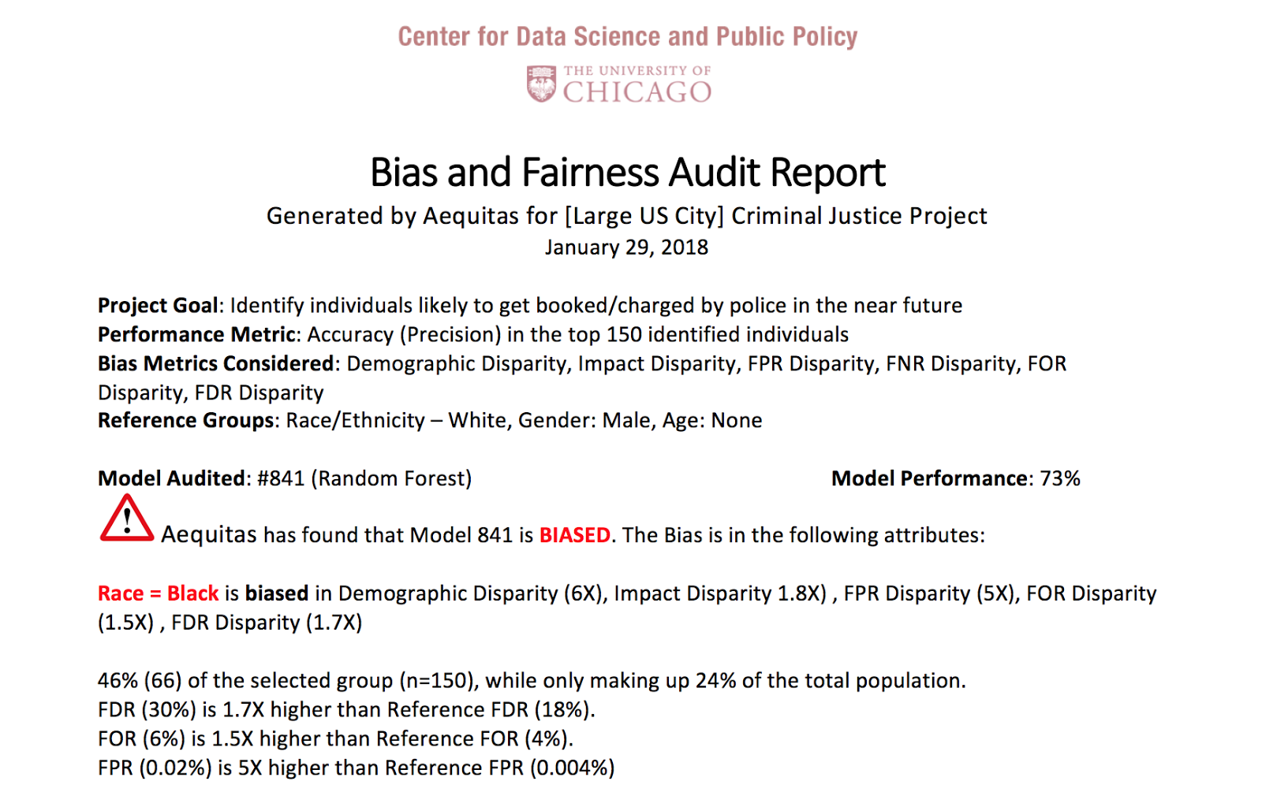
Aequitas: Bias Audit Tool
http://www.datasciencepublicpolicy.org/aequitas/ Joint Work with Pedro Saleiro

Slide 26
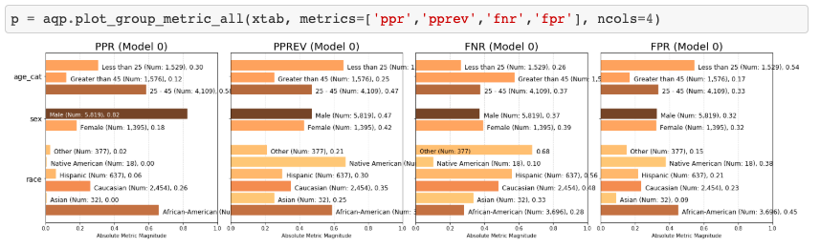
Auditing COMPAS Disparities

Slide 27
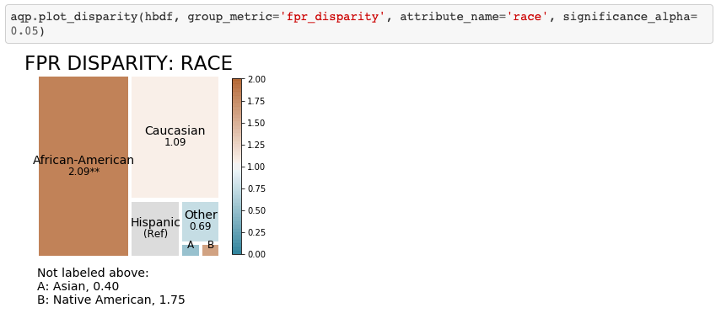
Auditing COMPAS Disparities

Slide 28
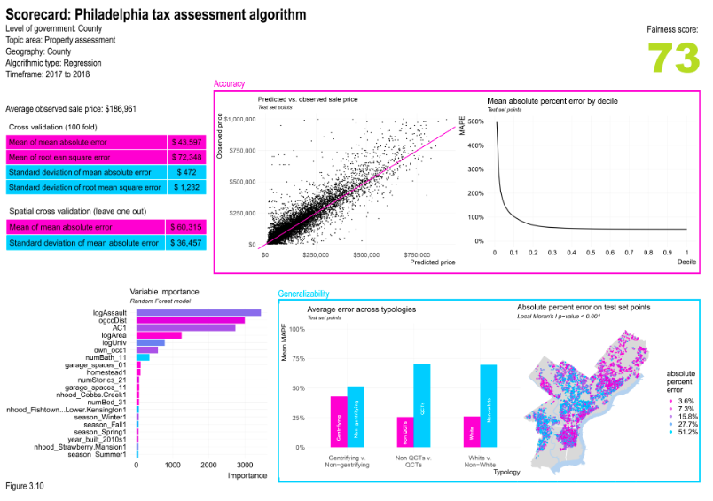
Fairness Scorecards
https://urbanspatial.github.io/AlgorithmicFairness_ACodebasedPrimerForPublicSectorDataScientists/

Slide 29
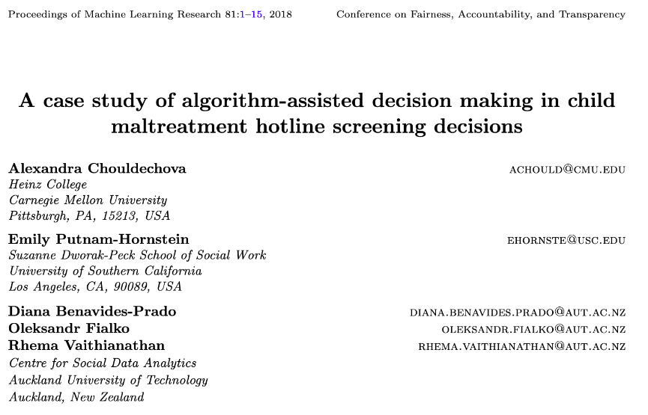
Child Welfare Case Study

Slide 30
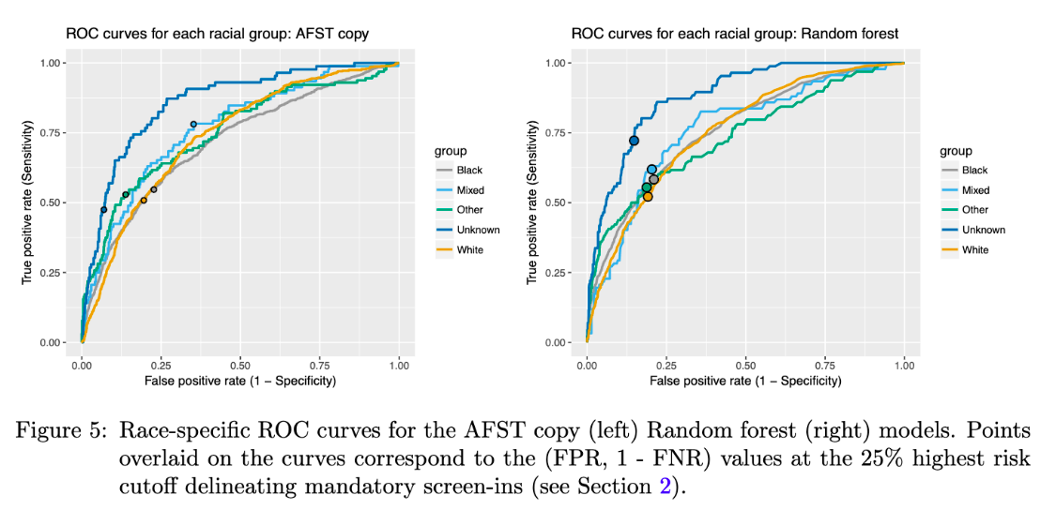
Child Welfare Case Study

Slide 31
Child Welfare Case Study
“We see that even though the ROC curves lie quite close to one another for most groups, the chosen threshold corresponds to different points on the ROC curves for different groups…. This FPR imbalance could lead to a perception that Mixed-race families are over- investigated relative to White families.
”

Slide 32
Where does this leave us?
What can we do to understand bias and improve fairness of our systems?
Bias and equity audits
Try to fix the input data
Optimize for fairness in model training
Choose fair models during model selection
Post-hoc adjustments to de-bias model scores
Measure relative effectiveness of interventions across groups and develop better-tailored interventions

Slide 33
0%
Performance Metric
100%

Slide 34
100%
Bias
0%
Performance Metric
100%

Slide 35
Case Study: Prioritizing Early Diabetes Screenings in a fair and equitable way

Slide 36
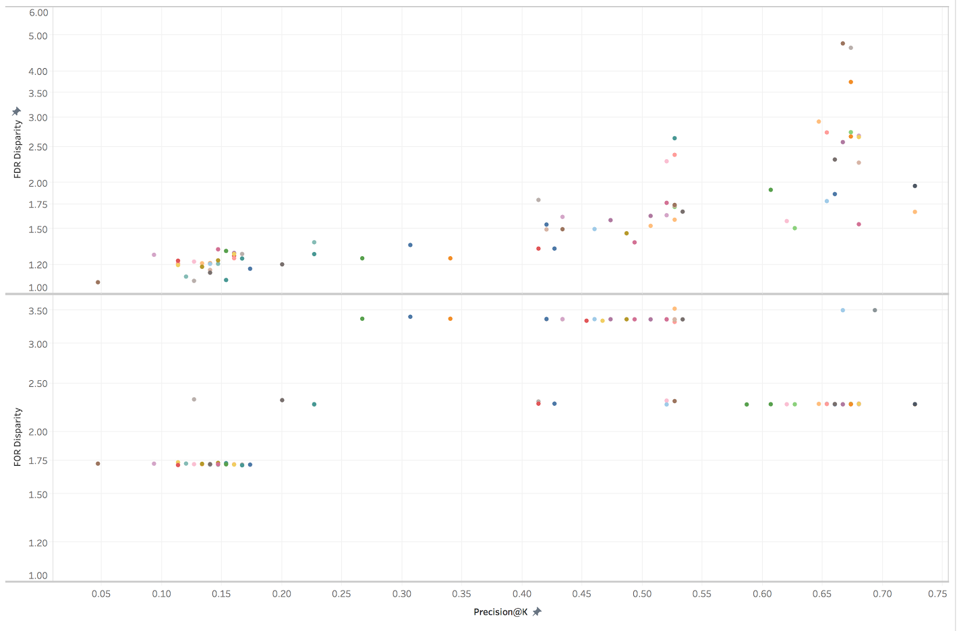
Bias vs P@10% on Gender
False Discovery Rate Disparity
False Omission Rate Disparity
Precision at the top 1%

Slide 37
Where does this leave us?
What can we do to understand bias and improve fairness of our systems?
Bias and equity audits
Try to fix the input data
Optimize for fairness in model training
Choose fair models during model selection
Post-hoc adjustments to de-bias model scores
Measure relative effectiveness of interventions across groups and develop better-tailored interventions

Slide 38
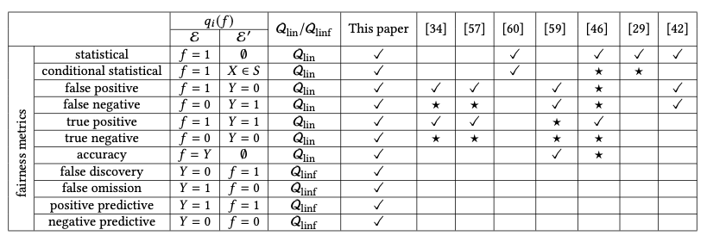
Optimize for Fairness in Model Training
General idea: modify optimization problem (for instance, by adding regularization terms to loss function) that account for fairness. Many implementations of different methods for various fairness metrics.

Slide 39
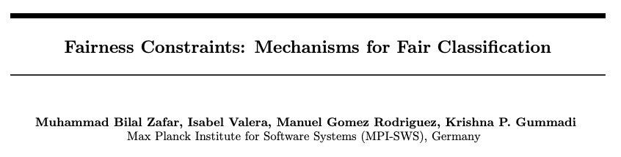
Optimize for Fairness in Model Training

Slide 40
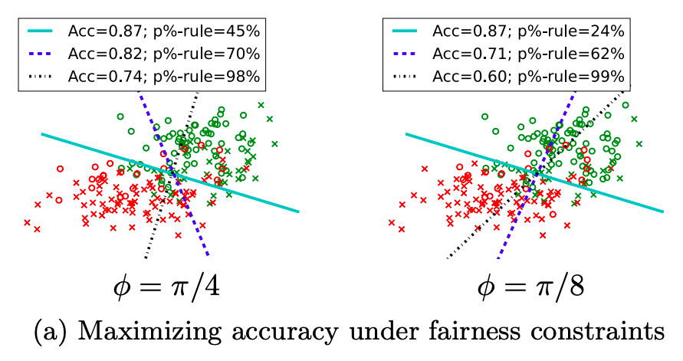
Optimize for Fairness in Model Training

Slide 41
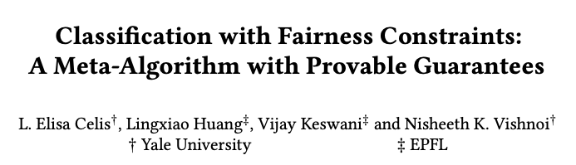
Optimize for Fairness in Model Training

Slide 42
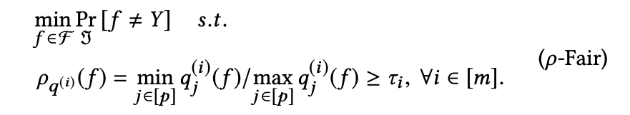
Optimize for Fairness in Model Training

Slide 43
Optimize for Fairness in Model Training
“group performance function”
capturing the equity metric
of interest

Slide 44
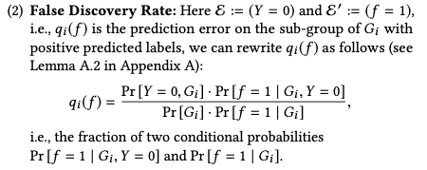
Optimize for Fairness in Model Training
for example:

Slide 45
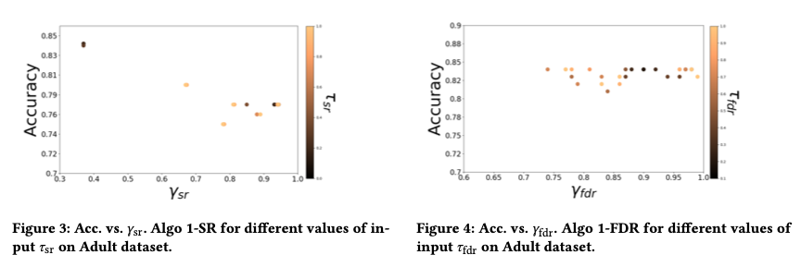
Optimize for Fairness in Model Training

Slide 46
Optimize for Fairness in Model Training: Advantages
Idea of an “all-in-one” solution is appealing
Provides some flexibility, especially when group membership not known exactly (e.g., gender estimated from name or race from census data)

Slide 47
Optimize for Fairness in Model Training: Limitations
Limited set of algorithms to do this directly, though also black-box options (often end up doing the same thing as post-hoc score adjustments)
Doesn’t preclude the need to auditing, assessment, and model selection – need to confirm the effectiveness of the constraint!
Generally don’t work well for “top k” problems off the shelf

Slide 48
Where does this leave us?
What can we do to understand bias and improve fairness of our systems?
Bias and equity audits
Try to fix the input data
Optimize for fairness in model training
Choose fair models during model selection
Post-hoc adjustments to de-bias model scores
Measure relative effectiveness of interventions across groups and develop better-tailored interventions

Slide 49
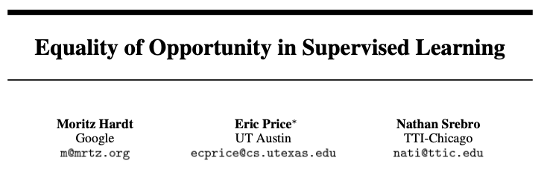
Post-hoc Adjustments

Slide 50

Post-hoc Adjustments
aka recall or TPR

Slide 51
Post-hoc Adjustments
“That is, to require that people who pay back their loan have an equal opportunity of getting a loan in the first place.
”

Slide 52
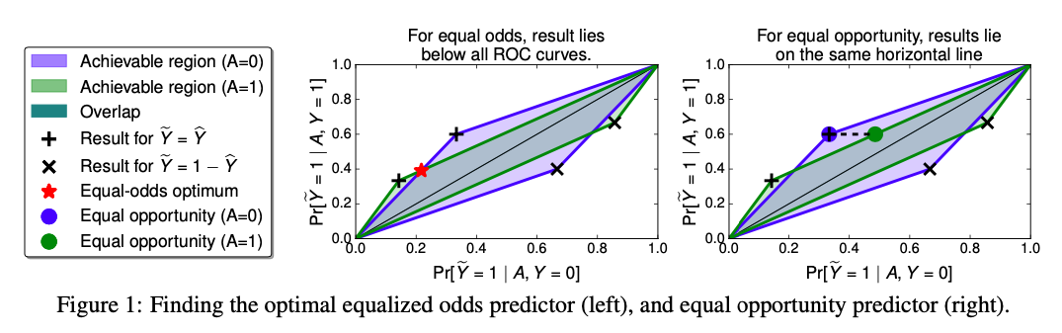
Post-hoc Adjustments

Slide 53
Case Study: Post-hoc Adjustments and Policy Goals
Cycle of Incarceration
UNMET
NEEDS
MISDEMEANOR
ARREST
JAIL
worsening or failing to improve

Slide 54
Case Study: Post-hoc Adjustments and Policy Goals
Breaking the Cycle
UNMET
NEEDS
X
MISDEMEANOR
ARREST
JAIL
TAILORED
INTERVENTION

Slide 55
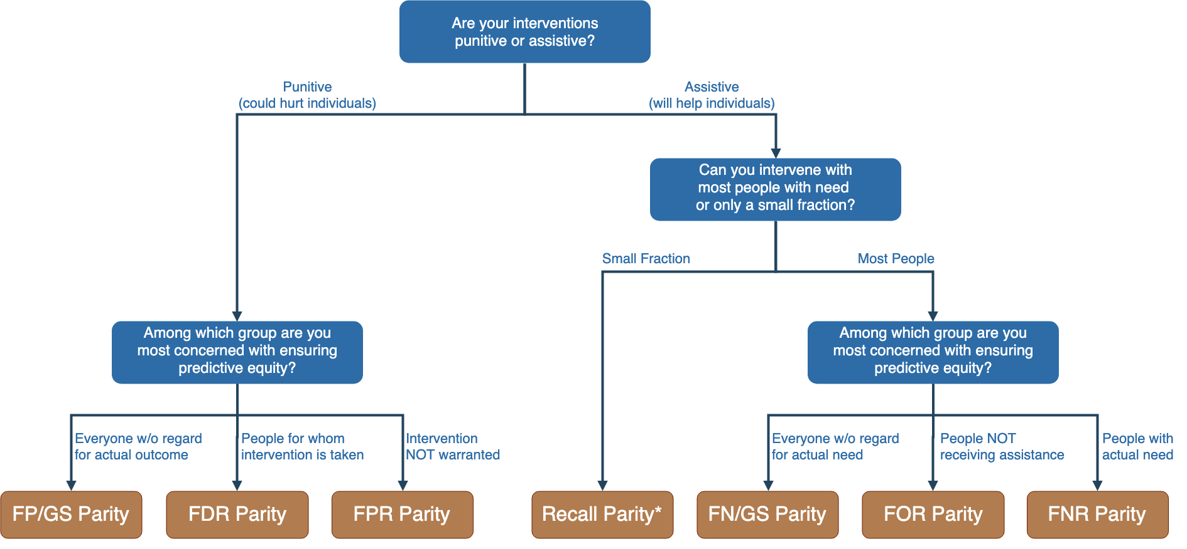
Notes:
Context-dependence of fairness definition
Idea of fairness tree is starting point for conversations with stakeholders, help guide discussion
In assistive program with resource constraints, focus on recall parity (equivalent to equality of opportunity discussed by Hardt and others --- also “sensitivity” and TPR and 1-FNR)

Slide 56
Notes:
Context-dependence of fairness definition
Idea of fairness tree is starting point for conversations with stakeholders, help guide discussion
In assistive program with resource constraints, focus on recall parity (equivalent to equality of opportunity discussed by Hardt and others --- also “sensitivity” and TPR and 1-FNR)

Slide 57
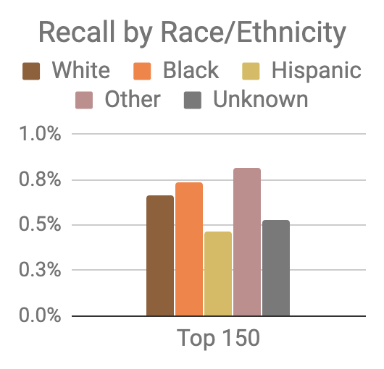
Model was optimized for efficiency, not equity
Top 150 highest risk reasonably balanced between black and white individuals
However, hispanic and unknown race/ethnicity groups very underrepresented

Slide 58
Mitigating Disparities
Single Threshold
White
Black
Hispanic
Recall
Lower Scores / Higher Recall
Group Thresholds
Recall

Slide 59
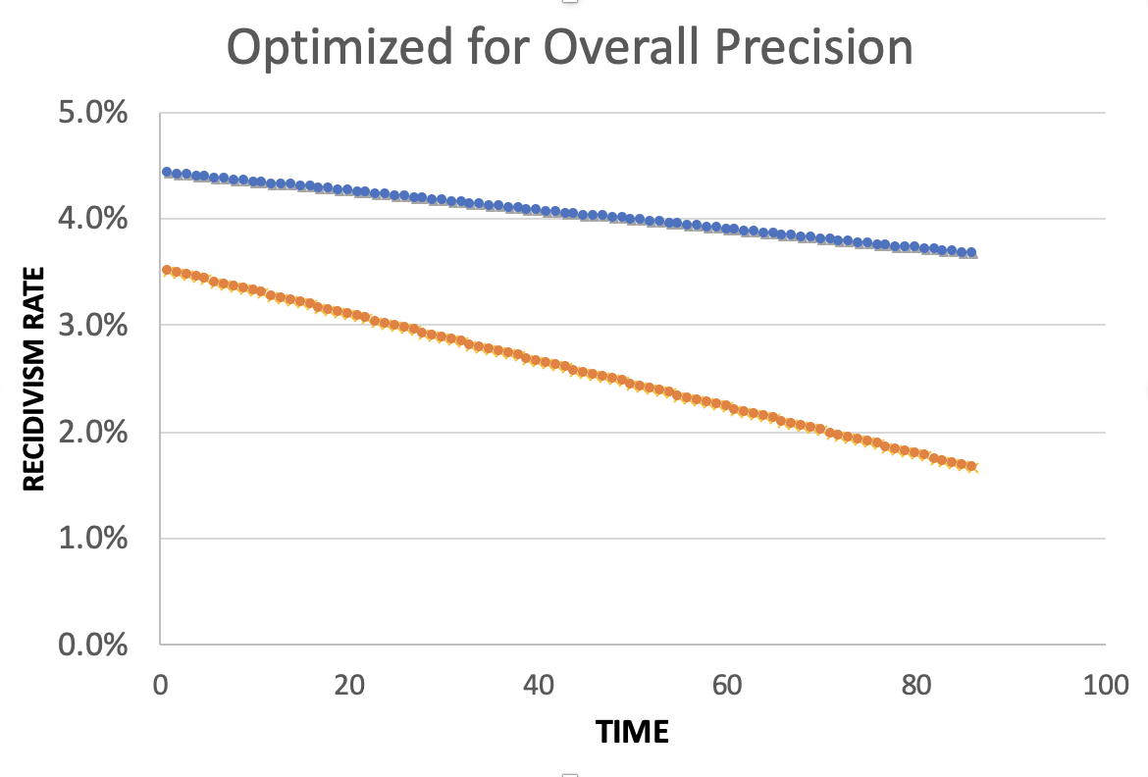
Equality of Predictions vs Underlying Disparities
Widening Gap:
Disparities Getting
Larger Over Time

Slide 60
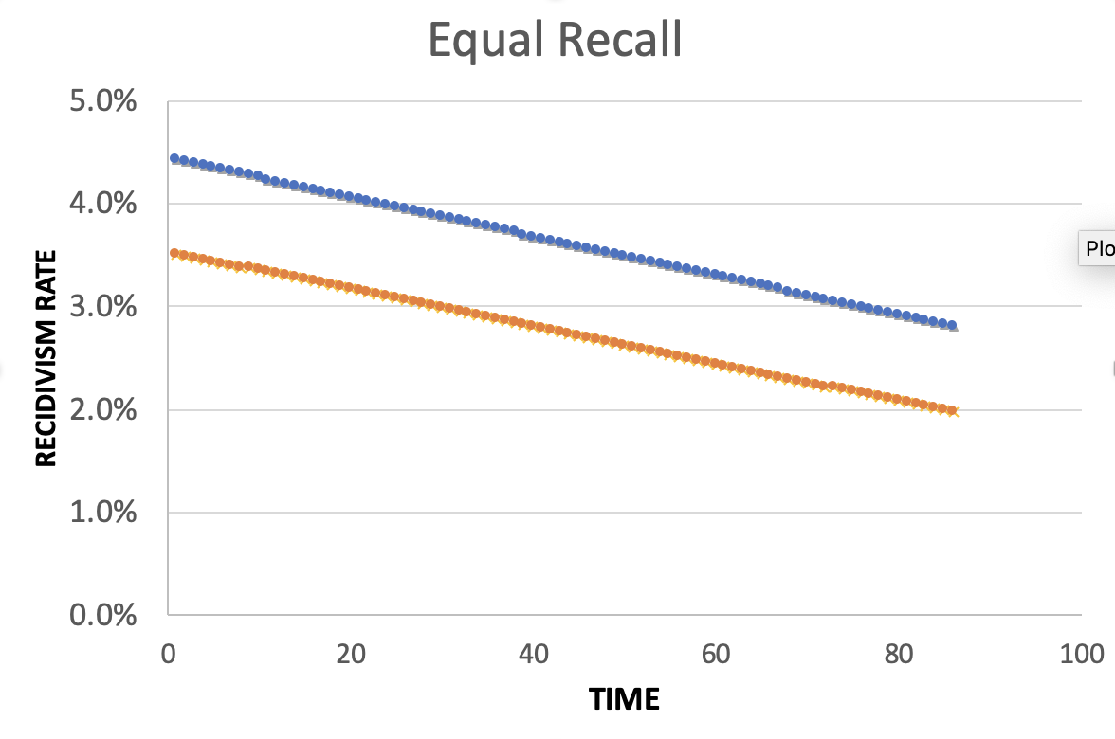
Equality of Predictions vs Underlying Disparities
Parallel Lines:
Disparities Remain
Constant Over Time

Slide 61
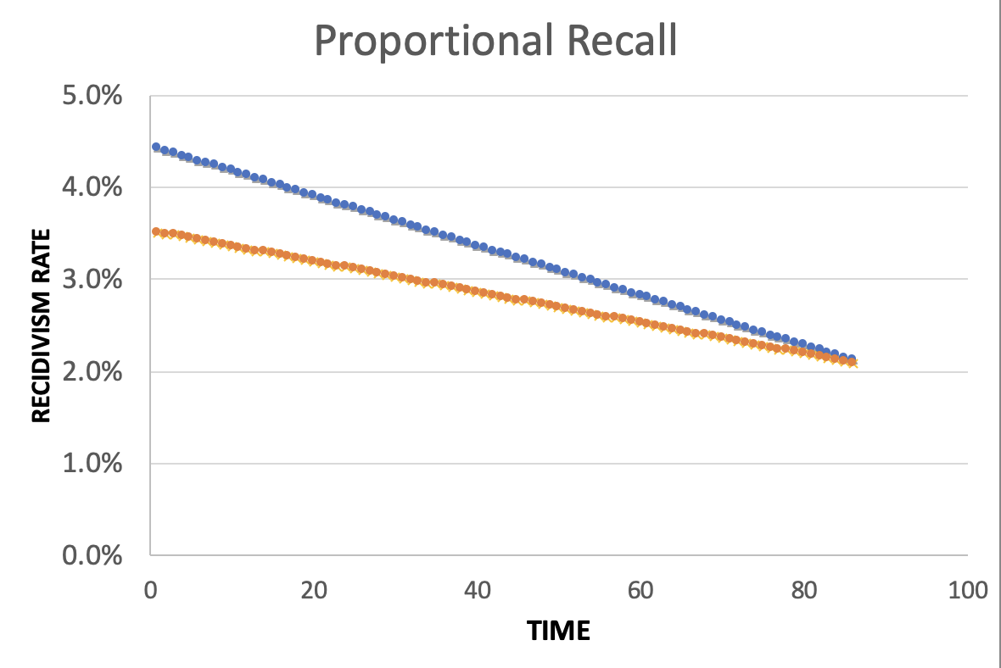
Equality of Predictions vs Underlying Disparities
Converging Lines:
Disparities Decrease
Over Time

Slide 63
Menu of Options
Current Scale
Expanded Scale
No
Constraint
Equalize
Recall
Reduce
Disparities

Slide 64
Menu of Options
Current Scale
Expanded Scale
No
Constraint
INITIAL
MODEL
Equalize
Recall
Reduce
Disparities

Slide 65
Menu of Options
Current Scale
Expanded Scale
No
Constraint
Equalize
Recall
EXPLICIT
EQUITY / EFFICIENCY
TRADE-OFF
“COST OF
EQUITY”
Reduce
Disparities

Slide 66
Menu of Options
Current Scale
Expanded Scale
No
Constraint
Equalize
Recall
IMPROVE OUTCOMES AT SAME
RATE ACROSS GROUPS
Reduce
Disparities
IMPROVE OUTCOMES FASTER FOR GROUPS
WITH HIGHER INCARCERATION RATES
Notes:
For the “Reduce Disparities” options, we targeted recall levels in proportion to underlying prevalence in the population. Could make other choices, but this has the nice property of readjusting as these prevalences change while also still distributing resources across all groups, but one could reasonably take many possible approaches.

Slide 67
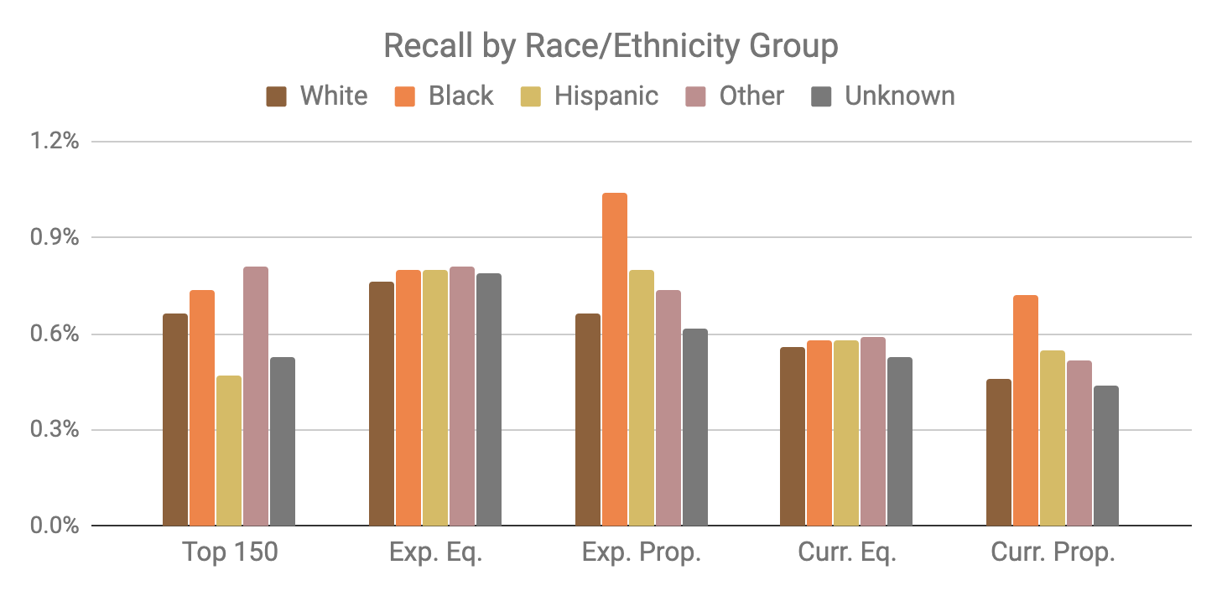
Base Model
Expanded Scale
Current Scale

Slide 68
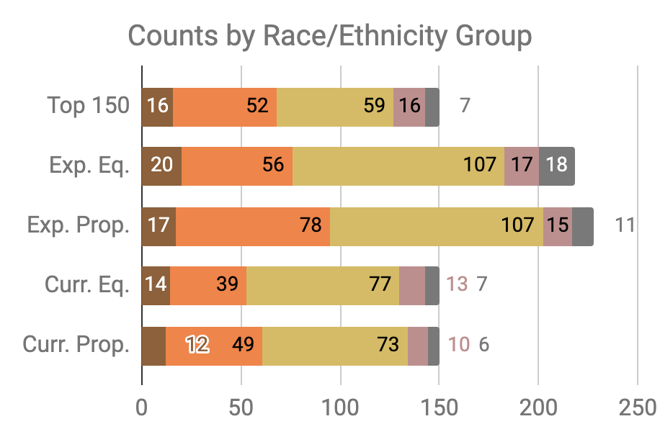


Slide 69
Little Equity/Efficiency Trade-Off at Current Scale
Top 150
72.7%
Precision
150
Total Count
Equal
Recall
70.7%
Precision
150
Total Count
Proportional
Recall
70.7%
Precision
150
Total Count

Slide 70
Three Concepts of Fairness in ML
We’ve focused here on the concept of group fairness – balancing aggregate metrics across groups
Some also study the concept of individual fairness – that similar individuals should be treated similarly
An important related line of work concerns counterfactual fairness – how would your prediction if you were a member of a different group?

Slide 71
Practical Challenges with Individual Fairness
How do you measure “similarity”? Over what distance metric and what features?
Individual fairness doesn’t guarantee group fairness (but also vice-versa)
In the light of existing or historical discrimination, the protected attribute / group membership might be an important measure of dissimilarity in itself

Slide 72
Data and AI Ethics Issues
Privacy
Data Ownership
Bias, Equity, & Fairness
Transparency
Trustworthiness and Accountability

Slide 73
What do we need
Training (for analysts, managers, and policymakers)
Bias Audit Checklists and Processes
Tools (to help AI developers build equitable systems) that are embedded in to the workflow
“Insurance” Budget to test, monitor, and evaluate systems for equity
Regulations and Review Boards

Slide 74
Steps we’re taking
Training (lots of it)
Tools – for different stages of projects embedded in the ML and project workflow
Case Studies
Providing choices with clear policy implications
Focus on outcomes and actions – fair outcomes
Experiments
Research
Discovering biased populations subgroups when we don’t have predefined “protected” groups
Detecting causes/sources of Bias
Comparing different approaches to “correct” for the bias
Using bias as a primary metric to do model selection over time

Slide 75
Summary
Create an environment where informed ethical discussions can take place
Talk through ethical issues at each stage of the project (instead of waiting till the end of stopping after the initial setup)
Consider the entire chain of data - collection to analysis to action
Consider how it affects people throughout the chain – especially the people being affected (and include them in these discussions)
Embed ethics into both technical processes as well as people processes

Slide 76
Readings
Policy Paradox
Ethics and Data Science
Ethics and Policy in Data Science (Class at Cornell)
First, Do No Harm
FATML (workshops that have been happening for the past 4 years)

Slide 77
Useful Resources
Data Science Project Scoping Guide
Data Maturity Framework
Hitchhikers Guide to DSSG: Data Science Tutorials
Data Science Tools
Triage: data science pipeline (under development)
Aequitas: Bias Audit Tool (under development)
Explainer: Explaining individual predictions from ML models (upcoming)
Code for other projects: www.github.com/dssg

Slide 78
Reminders
Assignment for Tuesday:
On Canvas: https://canvas.cmu.edu/courses/13277/assignments/244319
Updates based on feedback
Fairness metrics and simple bias audit
Readings for next week: Causality and Field Validation

